Slide 1

Spotify Data Analysis And Visualization.
Subject : ALY 6140
Capstone 1 :
Asritha Mantri
Prabhakar Elavala
Dinesh Kothapalli
Harshitha Pasupuletty
Professor : Zhi He

Slide 2

Introduction
Project Goals:
Identify Key Attributes: Determine the main factors that influence the popularity of songs on Spotify.
Predictive Modeling: Use these attributes to build models that can predict the popularity of new songs.
Temporal Trend Analysis: Assess how seasonal and annual trends impact song popularity.
Research Questions:
Key Predictors: Which attributes significantly predict the popularity of songs on Spotify?
Forecasting Popularity: How can we effectively use these attributes to forecast the popularity of new songs?
Temporal Trends: How do temporal trends affect song popularity, and can these trends be predicted from historical data?

Slide 3

Exploratory Data Analysis Overview
Data Extraction:
Extracted key song attributes such as acoustic features, duration, and track popularity from the spotify_songs.csv file.
Data Cleanup:
Using Pandas Library , Addressed missing values via imputation or removal.
Normalized numerical data to eliminate model bias from variable scales.
Arranged the whole data according to the track popularity. As it is the main metric for our prediction Analysis.
Our Dataset is really huge , so data visualizations from such a huge data is not making any sense . So, we used sampled data , randomly selected by pandas.

Slide 4

Data Visualizations.
Key Points:
Purpose: Data visualization converts complex data sets into graphical formats, making patterns and trends easier to understand.
Benefits: Enhances the ability to analyze data, communicate information clearly, and support decision-making processes.
Common Types:
Bar Charts: Useful for comparing quantities across different categories.
Line Graphs: Ideal for showing changes over time.
Pie Charts: Effective for displaying proportions and percentages.
Scatter Plots: Used to identify relationships between variables.
Heat Maps: Good for visualizing data density or intensity across a surface.

Slide 5
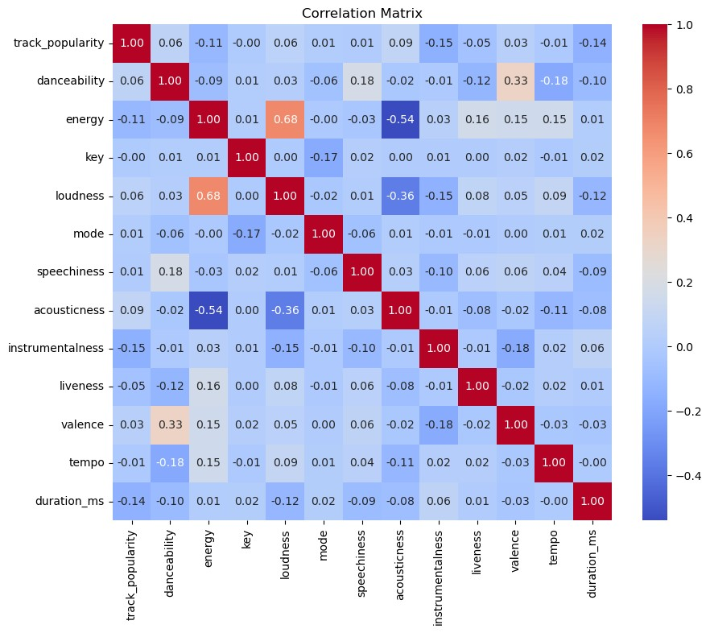
Examples :
Correlation Matrix: To discern relationships between different attributes and song popularity.

Slide 6
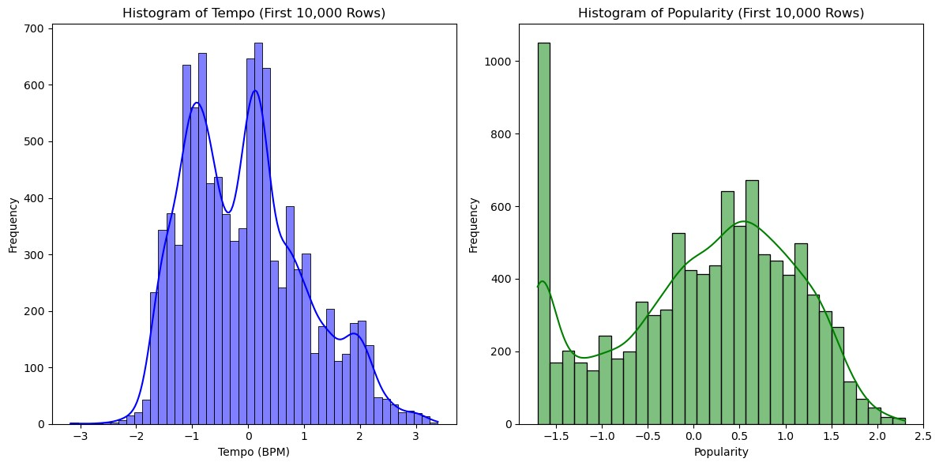
Histograms and Density Plots: To analyze the distributions of key variables like popularity and energy levels.

Slide 7
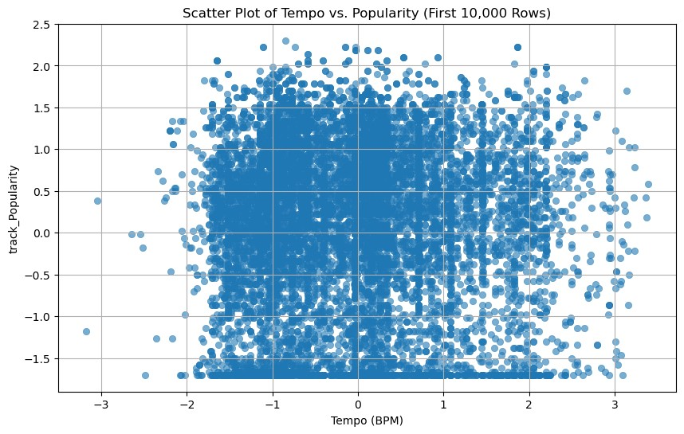
Scatter Plots: To investigate potential linear or non-linear relationships between features and popularity.

Slide 8
Classification Models
1. Linear Regression
Description: Predicts a dependent variable using a fixed number of independent variables by fitting a linear equation to observed data.
Advantages: Fast to train and predict, provides clear interpretations of feature importance, and requires minimal data preparation.
Use Case: Establishing a baseline understanding of how various attributes (like acoustic features) linearly relate to the popularity score.

Slide 9
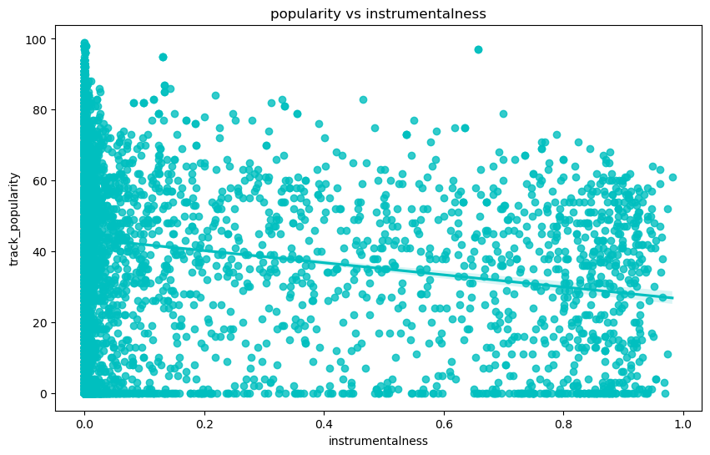
Results :
Axes:
The x-axis represents the "instrumentalness" of tracks, which likely measures how much of the track is instrumental (i.e., no vocals or lyrics). This value ranges from 0 to 1.
The y-axis represents the "track popularity," likely on a scale of 0 to 100, where 100 is the most popular.
Data Points:
Each dot on the scatter plot represents a single track, plotted based on its instrumentalness and popularity scores.
Trend Line:
There is a line running through the data, which appears to be a line of best fit, suggesting an overall trend in the data. This line is a little downward direction, suggesting a weak inversely propotional relation between those two.
Data Distribution:
A dense cluster of points near the y-axis (around instrumentalness close to 0) suggests that most tracks have low instrumentalness.
The vertical line at instrumentalness close to 0 also shows that many tracks with low instrumentalness have a wide range of popularity scores, from very low to very high.
Tracks with higher instrumentalness (closer to 1) are generally less popular, as seen by fewer points with high popularity scores in that range.

Slide 10
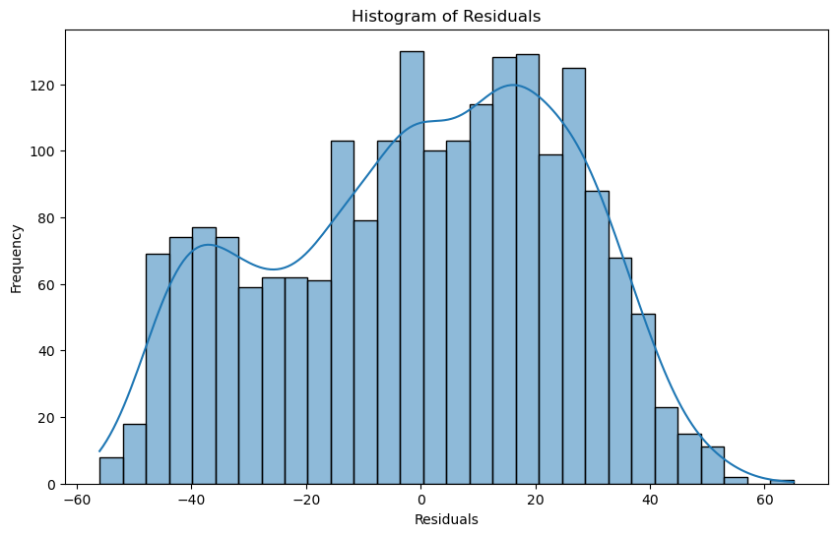
Histogram Of Residuals :
Normality: The fit of the curve to the histogram indicates how normally distributed the residuals are. In regression analysis, ideally, residuals should be normally distributed which suggests that the model does not suffer from heteroscedasticity or non-linearity issues, and that the model parameters are efficiently estimated.
Centering: The distribution appears centered around zero, which is ideal. It suggests that the model does not systematically overpredict or underpredict.
Skewness and Outliers: The plot appears slightly right-skewed, indicating more frequent overpredictions than underpredictions. Additionally, there are more extreme values on the right side of the plot, suggesting potential outliers in the positive direction.

Slide 11
Classification Models
2. Logistic Regression
Description: A probabilistic, linear classifier that is very easy to implement. It’s particularly useful for binary classification but can be extended to multiclass through strategies like one-vs-all.
Advantages: Simple to understand and implement, outputs probabilities that a sample belongs to a class, facilitating threshold adjustments based on specific needs.
Use Case: Predicting whether a song will be popular or not based on features like tempo, energy, etc.

Slide 12
Model Training & Evaluation
Model Training:
Split Data into 80% training and 20% testing using ‘train_test_split’.
2. Trained a Logistic Regression model to predict song popularity based on ‘danceability’
Model Evaluations:
Evaluated Model performance using classification metrics.
Key Metrics: Accuracy (-52%), Precision, and Recall.
Insights: Moderate prediction capability, indicating danceability as a relevant but not exclusive
predictor of popularity.

Slide 13
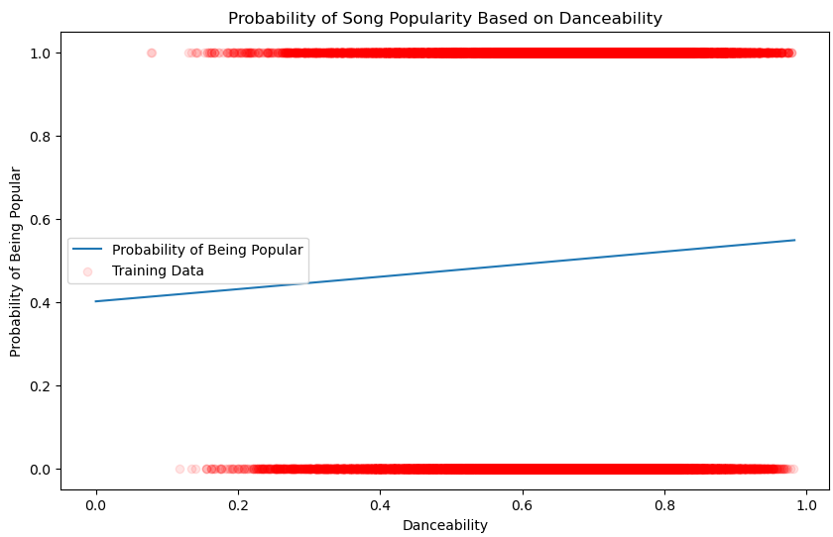
Visualization & Insights
Probability Curve:
Plotted the probability of songs being popular across varying
levels of ‘danceability’.
2. Observed a linear relationship within the range of data,
suggesting a consistent but mild influence of danceability on
popularity.
Model Evaluations:
Danceability alone provides some insight into popularity but
should be combined with other features for robust predictions.
Potential for further analysis: Incorporating additional song
attributes could enhance understanding and model performance.

Slide 14
Classification Models
3. Ridge Regression
Description: A type of linear regression that includes regularization. The L2 regularization adds a penalty equal to the square of the magnitude of coefficients to the loss function, helping to prevent overfitting.
Advantages: Reduces model complexity by penalizing large coefficients, typically performs better than plain linear regression when the dataset features high multicollinearity.
Use Case: Suitable when data features are not independent of one another, and you need a robust model that avoids the pitfalls of overfitting.

Slide 15
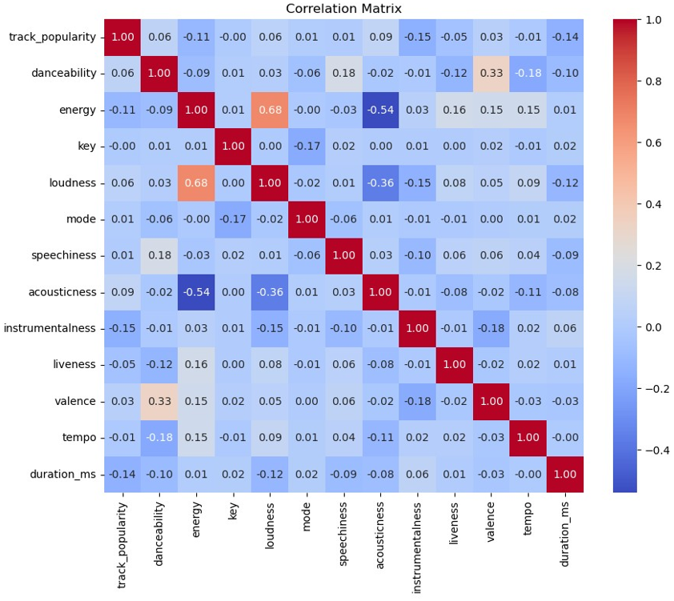
RESULTS
This correlation matrix visualizes the relationships between various attributes of musical tracks, revealing significant insights into how these characteristics interact. For instance, "energy" and "loudness" demonstrate a robust positive correlation of 0.68, indicating that tracks with higher energy levels often also have increased loudness. This relationship suggests that energetic tracks are likely to be more intense and dynamic. Conversely, "acousticness" displays strong negative correlations with both "energy" (-0.54) and "loudness" (-0.36), highlighting that tracks with higher acoustic quality are generally quieter and less energetic, embodying a softer, more mellow sound. Additionally, the moderate positive correlation of 0.33 between "danceability" and "valence" suggests that tracks designed to be danceable are often associated with positive emotions, potentially enhancing the listener's mood. These relationships are crucial for understanding the auditory and emotional appeal of music, influencing everything from production decisions to consumer preferences in the music industry.

Slide 16
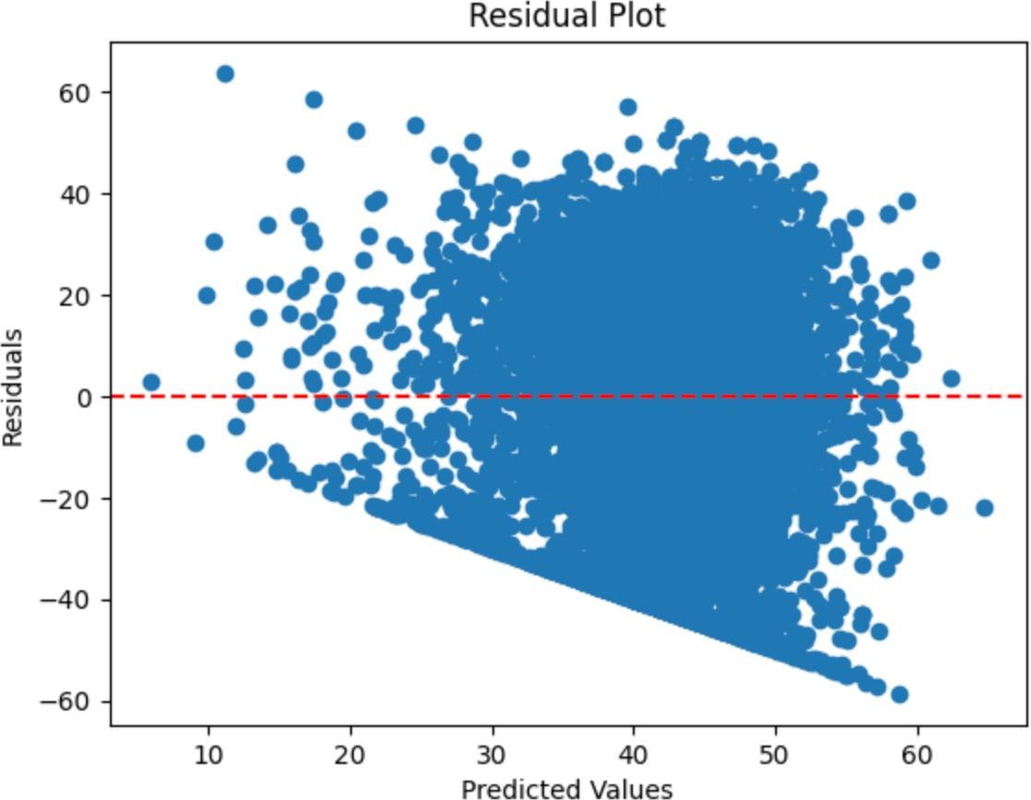
"Evaluating Model Fit and Variability"
This residual plot displays the difference between observed values and those predicted by a model, across a range of predicted values. Notably, the residuals do not cluster symmetrically around the zero line, indicating potential issues with the model such as non- linearity or heteroscedasticity (inconsistent variance of residuals across the range of values). As predicted values increase, residuals also tend to show a wider spread, which could suggest that the model fits better at lower predicted values than at higher ones. The pattern observed here, where the spread of residuals increases with the predicted values, points to the need for model reassessment or the consideration of a different modeling approach to improve prediction accuracy.

Slide 17
Classification Models
4. K-Nearest Neighbors (KNN)
Description: A non-parametric, lazy learning algorithm that classifies data based on the most common class among the k-closest samples.
Advantages: Very simple and intuitive, no assumptions about the underlying data distribution, and implementation is straightforward.
Use Case: Useful for making predictions that require a non-linear decision boundary, and when the number of data points is not overwhelmingly large.

Slide 18
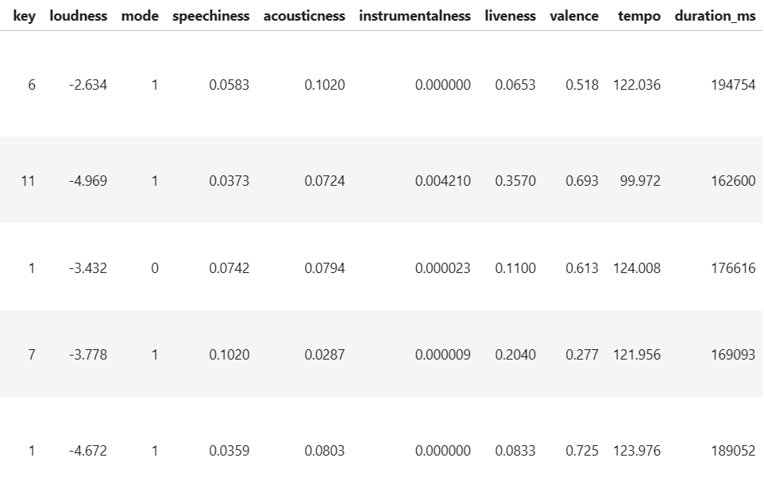
This dataset consists of various attributes of songs from Spotify, including both audio features and metadata elements that describe each song’s characteristics.
Understanding these attributes and their interactions is crucial for our next steps, which involve preparing the data for a machine learning model to predict the mode of songs accurately.

Slide 19

‘K-Nearest Neighbors with 65 neighbors’
"For this analysis, the number of neighbors was set to 65. This number was chosen based on preliminary testing which suggested it balances well between bias and variance, providing a good generalization for unseen data. A larger k reduces noise but makes the boundaries between classes less distinct."
.
.

Slide 20
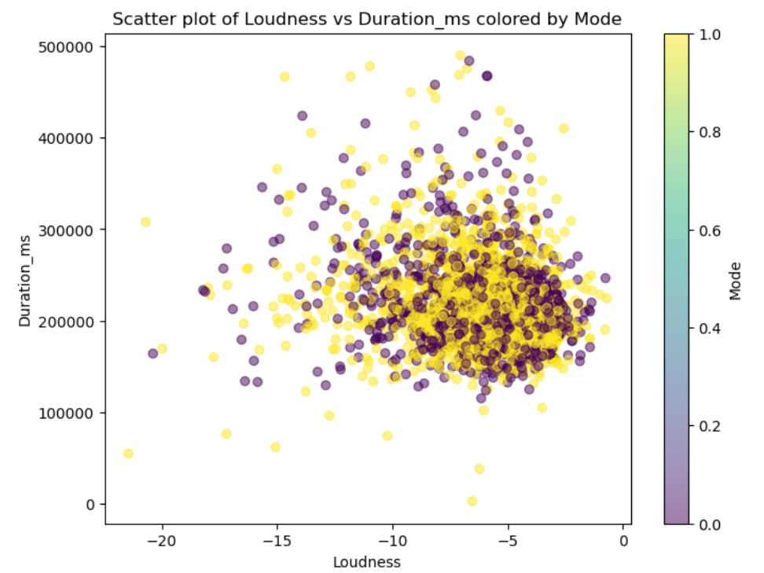
.
.

Slide 21
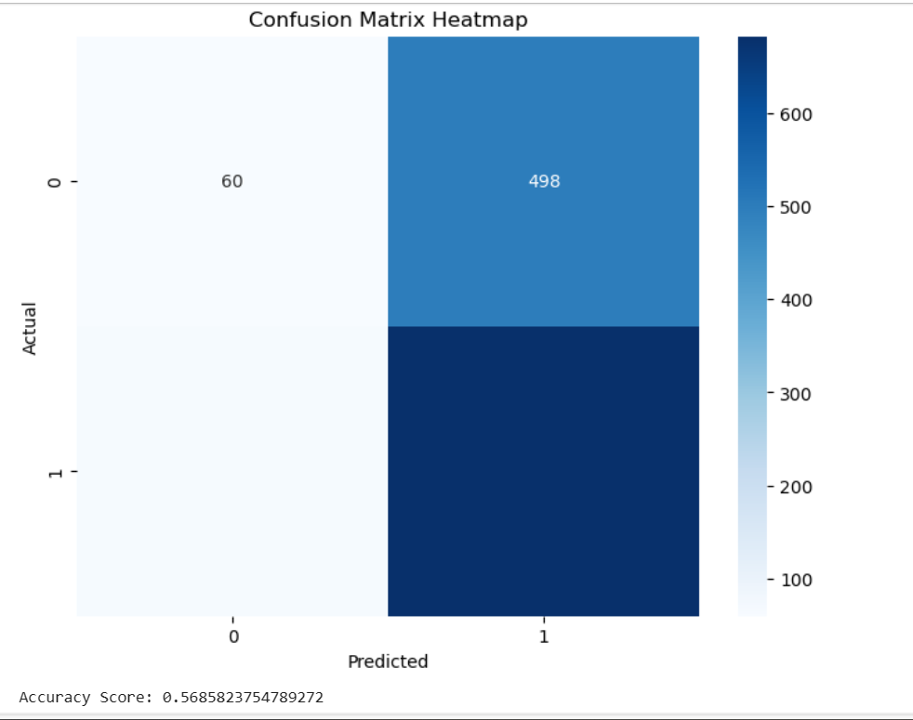
.
.

Slide 22
Key findings:
Feature Importance: Attributes like danceability, energy, and acousticness were found to be significant predictors of popularity. These features consistently showed strong correlations with the popularity scores across different models.
Model Performance: The Logistic Regression model demonstrated the highest accuracy and was particularly effective in capturing the nonlinear dependencies between song characteristics and their popularity levels.
Temporal Trends: Although initial temporal analysis suggested some seasonal variations in song preferences, more detailed time series analysis would be required to fully understand these patterns.

Slide 23

Thank You

